Slide 1
A Deep Learning Approach To Blind Deconvolution
Engineering research project
Hieu Le Xuan

Slide 2
CONTENT
01 | Introduction | 4
02 | Related Works | 6
03 | Method | 7
04 | Experiment | 11
05 | Conclusion | 14

Slide 3
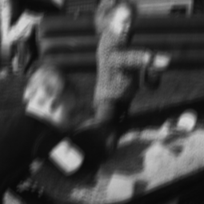
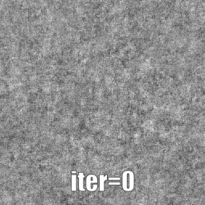
INTRODUCTION
01
Motivation: Why Blind Deconvolution?
Blind deconvolution : recovery latent image from blurry versions without knowing blur kernel
Heart of applications: Restoring distorted images, deblurring images, super-resolutions,etc...
Original Blurry Image
Our Results

Slide 4
INTRODUCTION
01
Our objectives
Reimplementing the deblurring system in the original paper [5].
Recognizing limitations within this work and improve them.
Main contributions
Successfully Re-implementing an efficient model for deblurring.
Proven that the usage of Total Variation regularization in the original paper is unnecessary
Novelty: Implement Variational Bayesian Deblur to optimize the network instead of Maximum a Posterior (MAP)

Slide 5
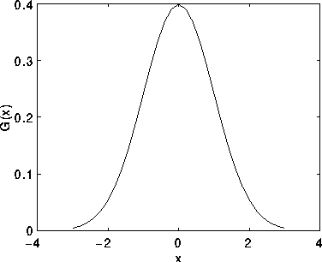
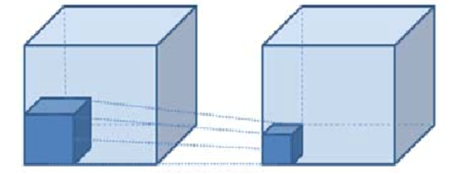
RELATED WORKS
02
Traditional Approaches
Deep Learning Approaches
Based on assumptions of blur kernels: distribution: Richardson [1]
May require user input: Fergus’s work [2]
Limitations:
May not be generalized
Not quite efficient in reality
Encoder-Decoder architecture with synthetic datasets: Gao[3], Li Xu [4]
Limitations:
Only work well for some specific type of blur kernels
May not work well for large blur kernel
*both image sources: medium.com

Slide 6
RELATED WORKS
02
Our selection
Neural Blind Deconvolution Using Deep Priors (2020)
Why selecting this paper?
Relaxed assumptions on blur kernels
Has been demonstrated to work well for complicated and large blur kernel

Slide 7
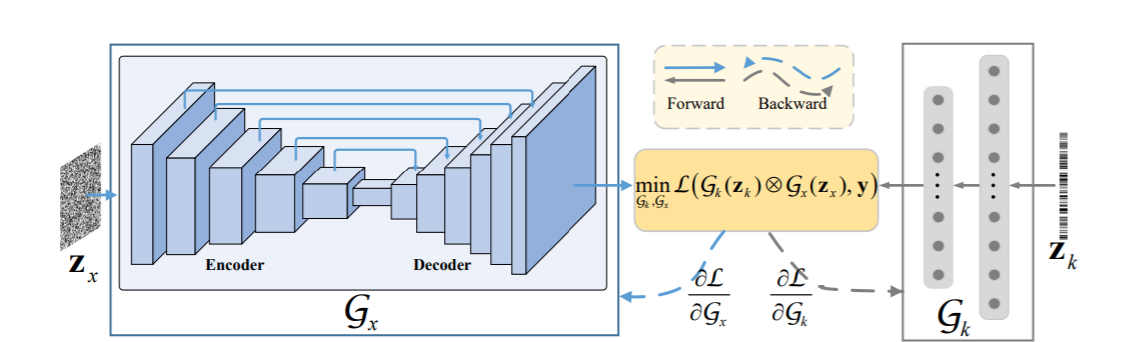
METHODOLOGY
03
Original paper’s method:

Slide 8
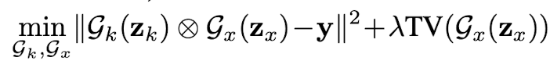
METHODOLOGY
03
Original paper’s method : Loss function
Where λ : the parameter for the TV (total variation) regularization
G_{x}: Generative network to generate latent image
G_{k}: Neural network for capturing blur kernel
Z_{x}, Z_{k} : input noise vectors

Slide 9
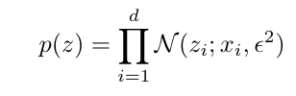
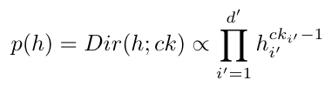
METHODOLOGY
03
Deep VB-based optimization approach
Latent image and blur kernel distribution based on data prior
x, y, k are ground truth clean image, blurry image and ground truth kernel.
z, h are latent image and blur kernel.

Slide 10
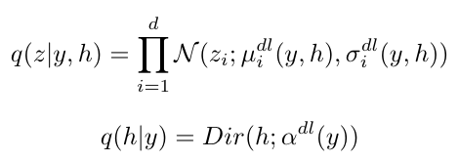
METHODOLOGY
03
Variational posterior distribution
Our idea is to use deep learning to estimate variational posterior distribution.

Slide 11
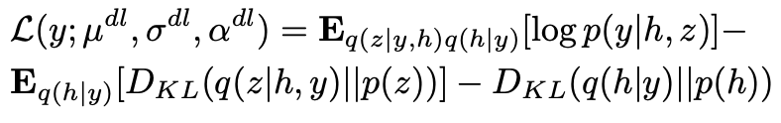
METHODOLOGY
03
Loss function
Minimize the negative lower bound (ELBO) function

Slide 12
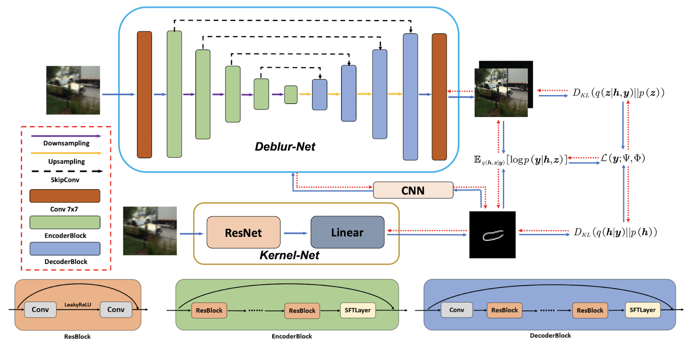
METHODOLOGY
03
Model architecture

Slide 13
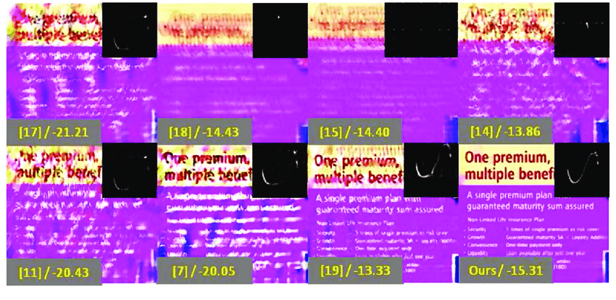
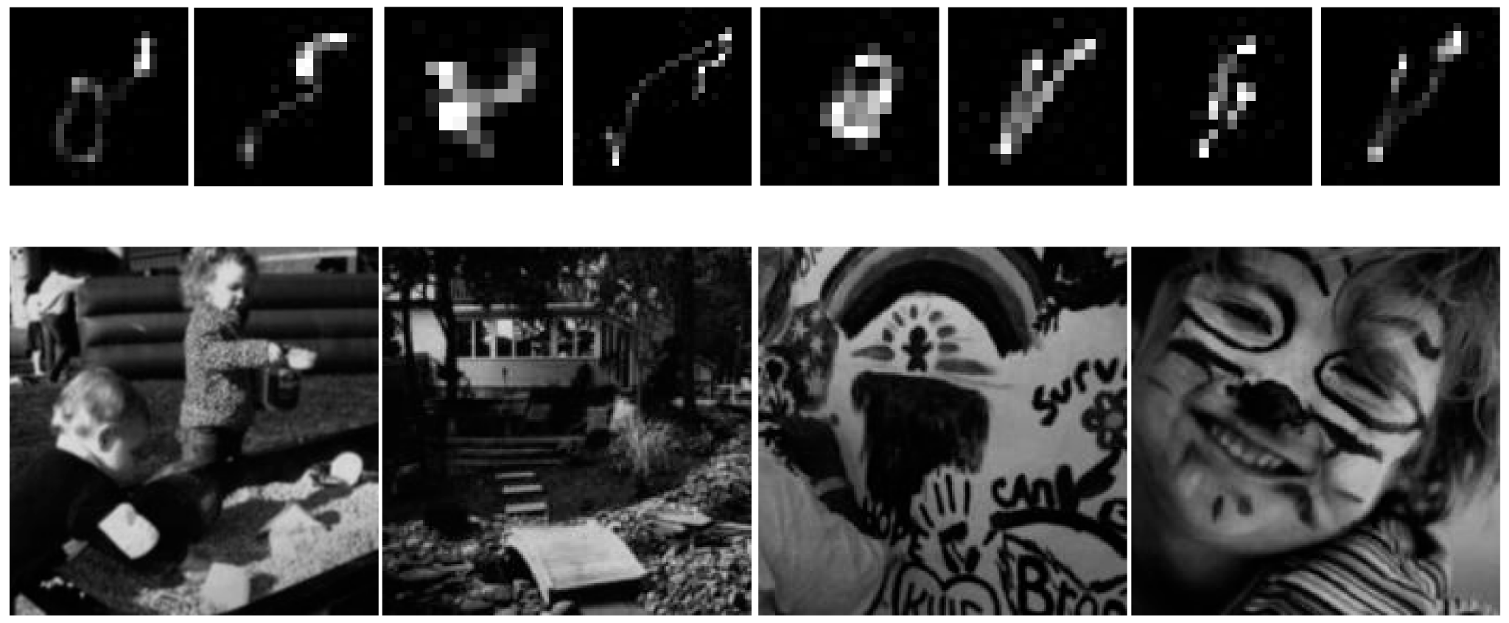
EXPERIMENT
04
Experiments are conducted on 2 datasets:
The Levin dataset (32 images) and the Lai dataset (100 images)
Samples from Levin dataset [6]
Samples from Lai dataset [7]

Slide 14
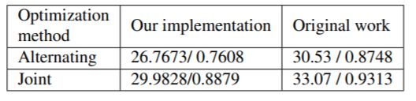
EXPERIMENT
04
In this section, we first replicated experiments in the original paper
First experiment: Joint optimization vs Alternating Optimization
Our setting: conducted on Levin dataset, 3000 iterations. Metrics: PSNR/SSIM
Alternating Optimization Pseudo code:
Compute loss
Freeze G_{x}, updating G_{k}
Re-compute loss
Freeze G_{k}, updating G_{x}

Slide 15
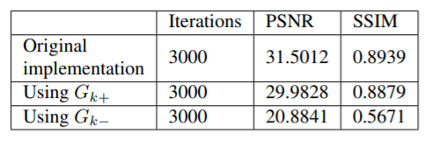
EXPERIMENT
04
Second experiment: Best structure for G_{k}
Our setting: conducted on Levin dataset, 3000 iterations
G_{k+} : add 1 more hidden layer
G_{k-} : delete the
hidden layer
*Data taken from the report

Slide 16
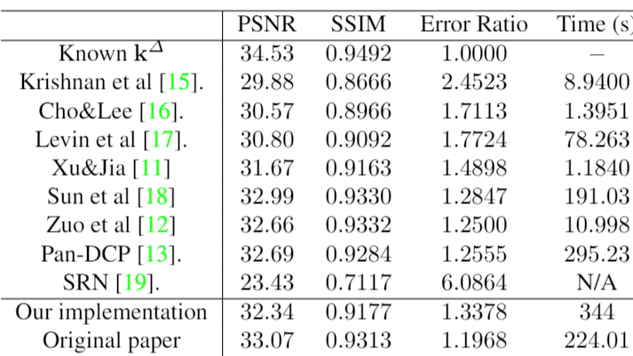
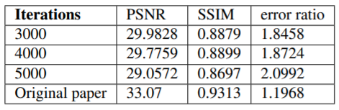
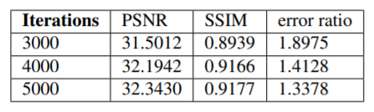
EXPERIMENT
04
Third experiments: Comparing with SOTA on Levin dataset
Our setting: No TV regularization, 5000 iterations
Using TV regularization
Without using TV regularization
*Data taken from the report

Slide 17
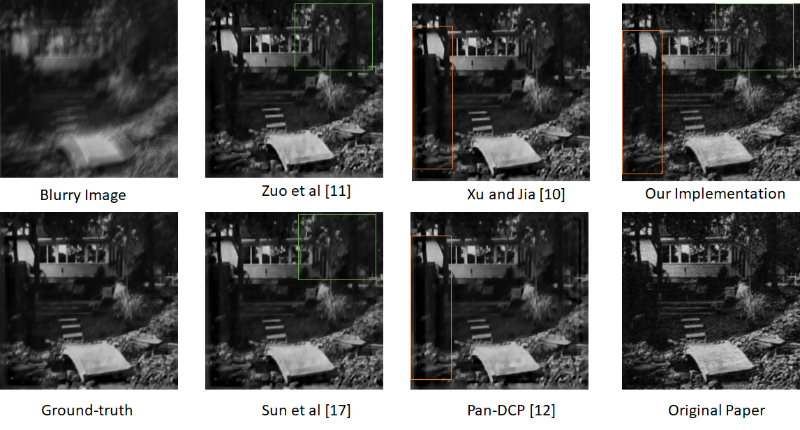
EXPERIMENT
04
Third experiments: Comparing with SOTA on Levin dataset

Slide 18
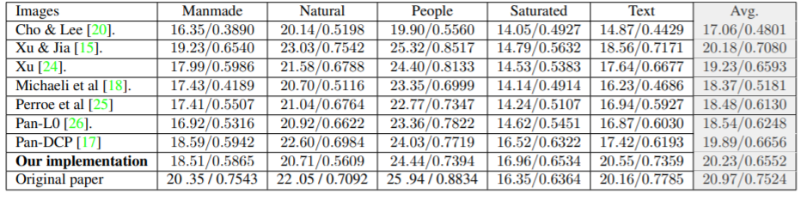
EXPERIMENT
04
Fourth experiments: Comparing with SOTA on Lai dataset
Settings: 2000 iterations. Metrics: PSNR/SSIM
*Data taken from the report

Slide 19
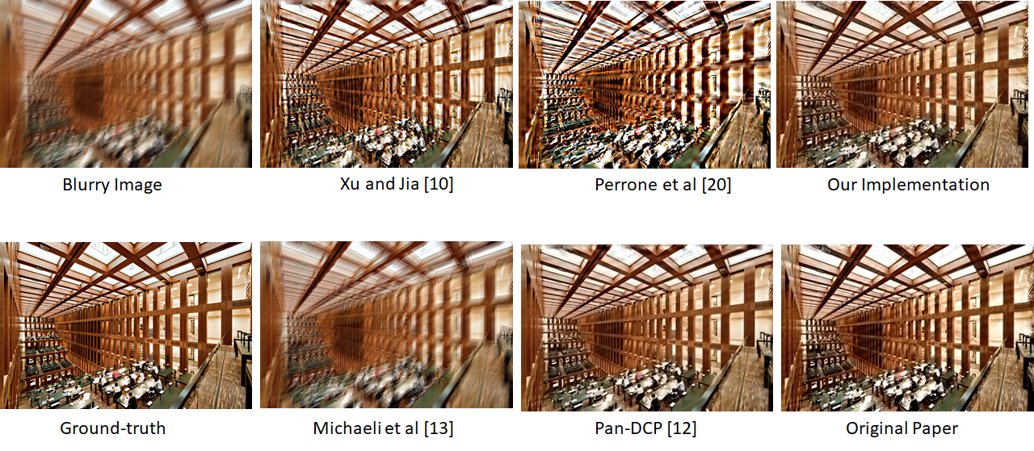
EXPERIMENT
04
Fourth experiments: Comparing with SOTA on Lai dataset

Slide 20
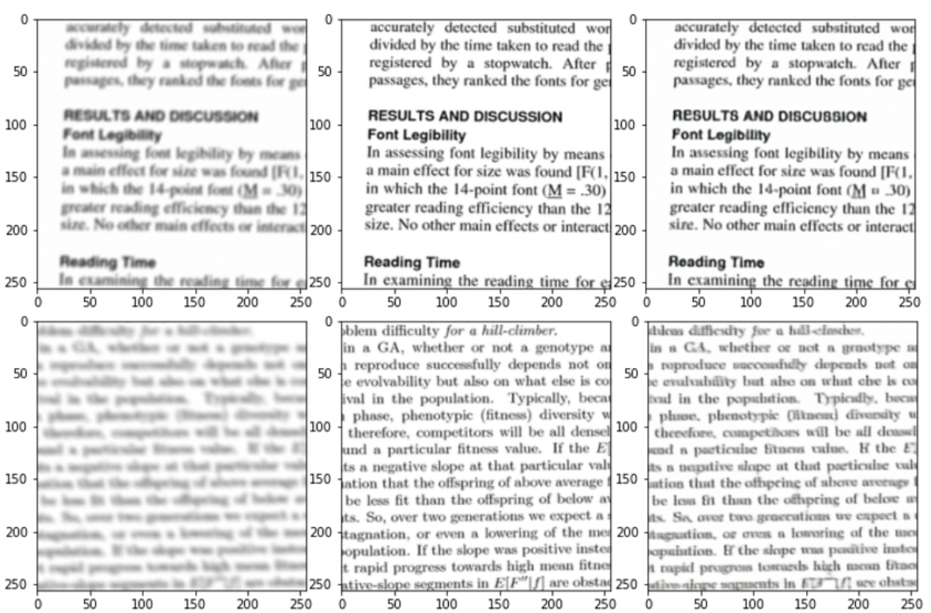
EXPERIMENT
04
VB-based deblur on Text dataset benchmark:
From left to right: blurry image, clean image and our generated image

Slide 21
CONCLUSIONS
05
Summary:
Despite limited resources, we achieved deblurring models with satisfactory performance on Lai and Levin dataset
Proven the usage of TV regularization is not needed
Provide a novel method for applying Bayesian framework

Slide 22
REFERENCES
William Hadley Richardson. Bayesian-based iterative method of image restoration. J. Opt. Soc. Am.,62(1):55–59, Jan 1972.doi: 10 . 1364 / JOSA . 62 .000055.
Rob Fergus, Barun Singh, Aaron Hertzmann, Sam T. Roweis, and William T. Freeman. Removing camera shake from a single photograph. ACM SIGGRAPH 2006 Papers on - SIGGRAPH 06, 2006. doi: 10.1145/1179352.1141956
Hongyun Gao, Xin Tao, Xiaoyong Shen, and Jiaya Jia. Dynamic scene deblurring with parameter selective sharing and nested skip connections. In 2019 IEEE/CVF Conference on Computer Vision and Pattern Recognition (CVPR), pages 3843–3851, 2019. doi:10.1109/CVPR.2019.00397
Li Xu, Jimmy S. J. Ren, Ce Liu, and Jiaya Jia. Deepconvolutional neural network for image deconvolution.In Proceedings of the 27th International Conference on Neural Information Processing Systems - Volume 1, NIPS’14, page 1790–1798, Cambridge, MA, USA, 2014. MIT Press. 1
D. Ren, K. Zhang, Q. Wang, Q. Hu and W. Zuo, "Neural Blind Deconvolution Using Deep Priors," 2020 IEEE/CVF Conference on Computer Vision and Pattern Recognition (CVPR), 2020, pp. 3338-3347, doi: 10.1109/CVPR42600.2020.00340.

Slide 23
THANK YOU

